Slide 1
Ancient history of gardens
Lesson 1

Slide 2
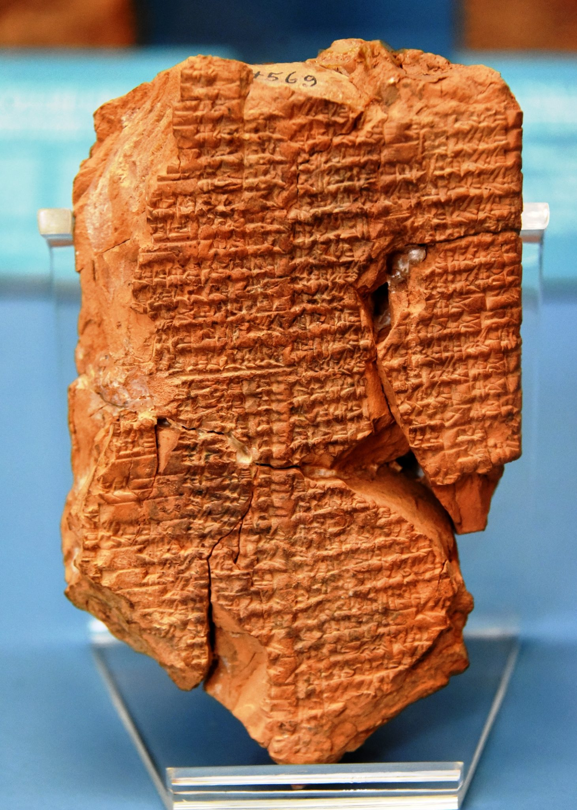
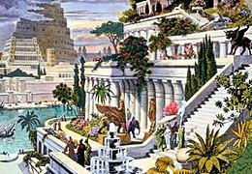
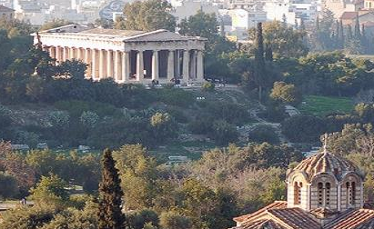
8 000 BC
590 BC
470 BC
Birth of agriculture (Mesopotamia - between 2 rivers).
This region is often referred to as the “cradle of civilization”, because it was in the fertile valleys between the 2 great rivers (Tigris and Euphrates) that the first communities developed thanks to agriculture.
Hanging gardens of Babylone According to tradition, they were built by the Assyrian queen Semiramis. They took shape thanks to the experiments they developed in the architectural, hydraulic and botanical fields. They were destined to become one of the Seven Wonders of the Ancient World.
Athens Agora
Cimone, a politician from Athens, decided to plant gardens in the Agora. In democratic Greece, greenery had to be above all public, open to everyone.

Slide 3
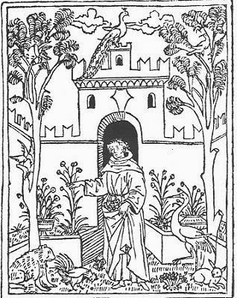
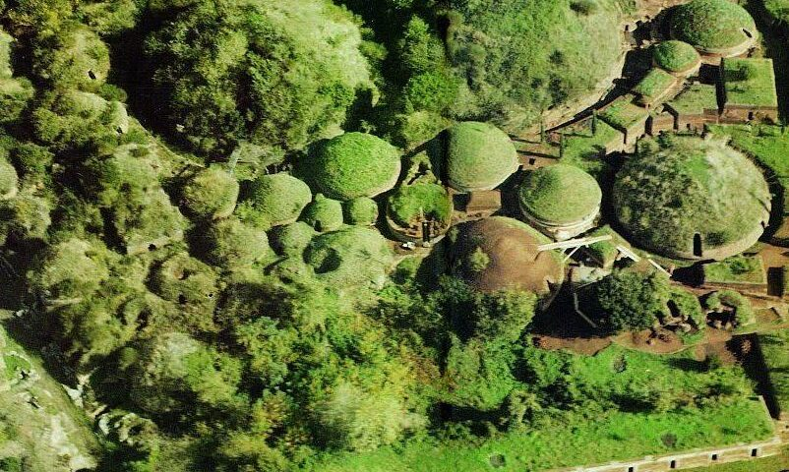
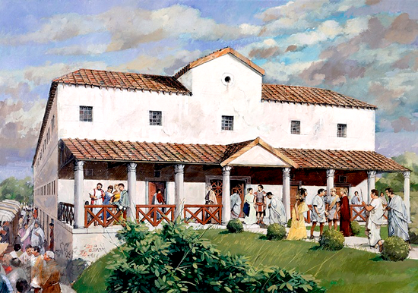
From 300 BC
From 200 BC
From 529
Among the Etruscans
The first writer to mention a "hortus" was Plinio il vecchio, who wrote about the garden of Tarquinio il Superbo, the seventh and last Etruscan king of Rome. In fact, the Etruscans were so fond of greenery that their rock necropolises had gardens.
Among the Romans
In the peristyle, inside Roman villas, there were the "hortus". The vegetable patch and garden represented an oasis of peace and tranquillity, a refuge from city life, a place full of religious and symbolic significance.
Benedictine gardens
"Ora et Labora" Benedetto da Norcia composed his Rule in which he wrote "The monastery, then, must possibly be organised in such a way that inside it you can find everything you need, water, mill, vegetable garden and various workers...".

Slide 4
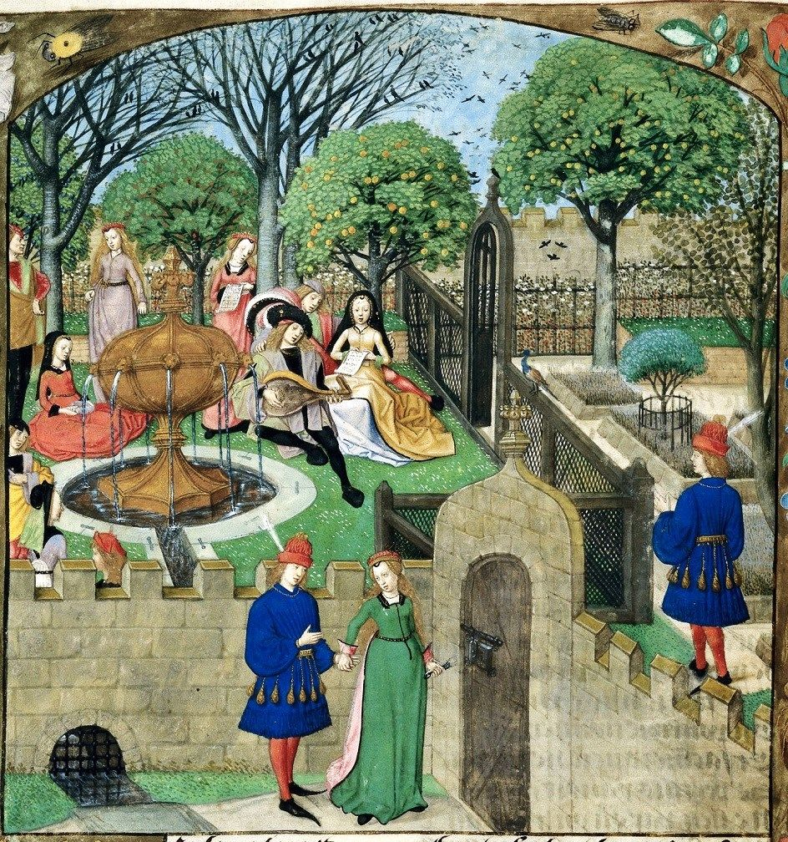
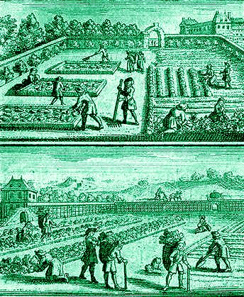
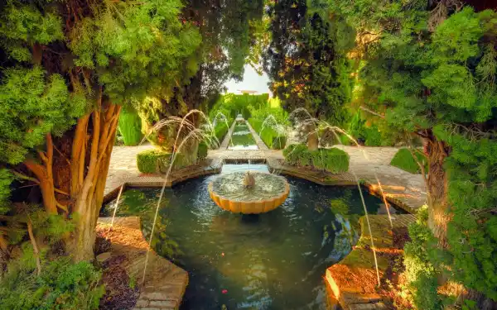
800-1000
1100 – 1450
1660
The Arab garden
The Arabs are credited with introducing a number of important cultivated species to Mediterranean Europe, including aubergines, lemons, oranges, peaches, apricots, cotton, sugar cane, rice and carob.
Hortus Conclusus
In the medieval town, behind the houses, there were kitchen gardens where aromatic herbs, staple vegetables and sometimes vines and fruit trees were grown.
Vegetable garden
Jean De La Quintinie, a student of botany, created the first vegetable garden for King Louis XIV at the Château de Versailles (covering 10 hectares), which at the time was one of the most important centres of experimentation in Europe in this field.

Slide 5
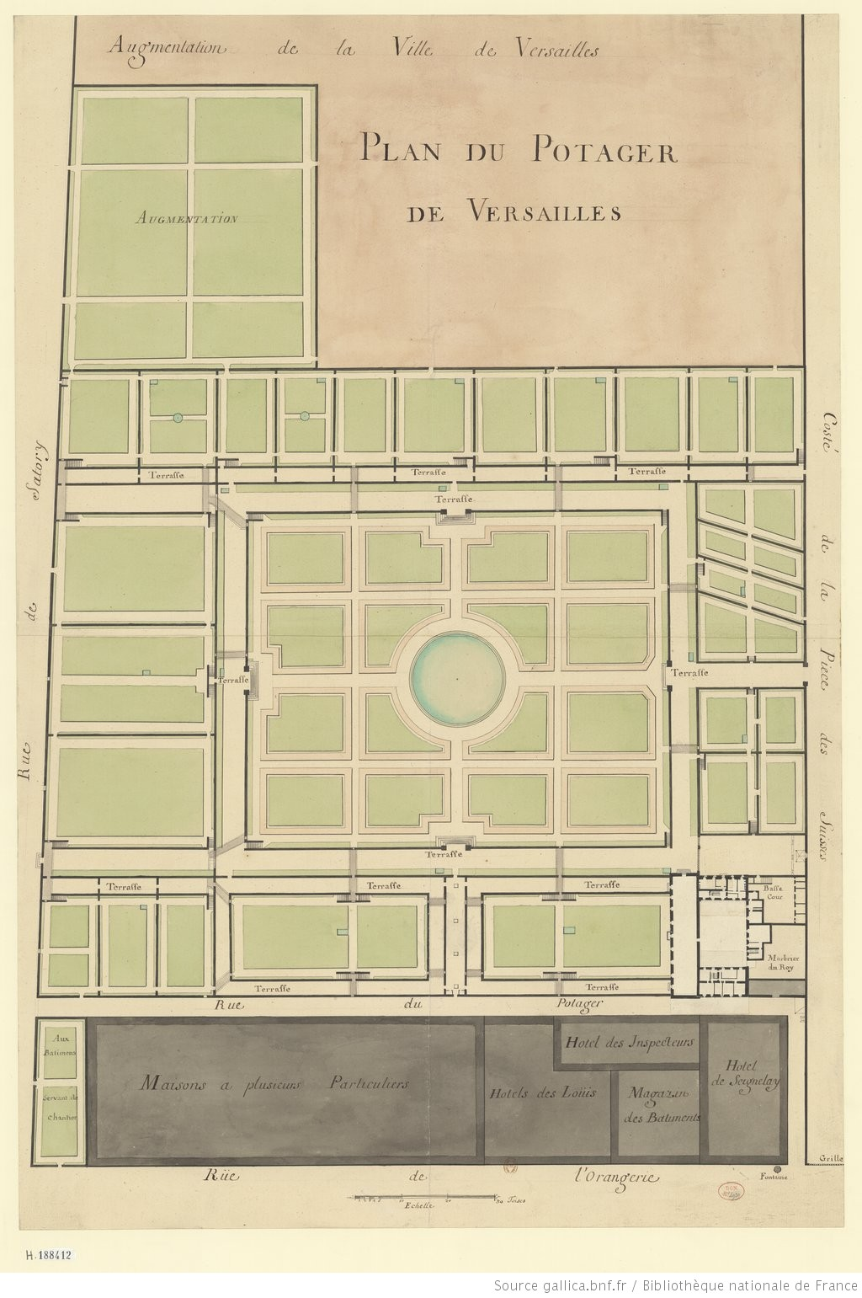
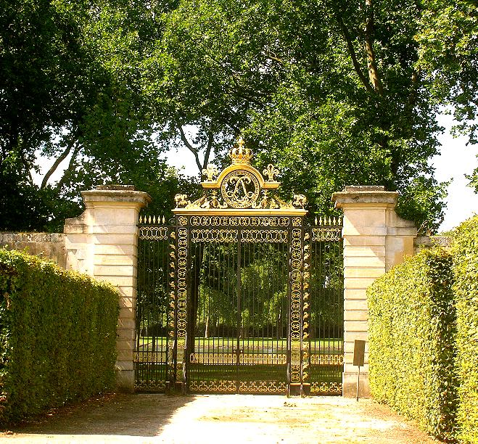
Plan of the kitchen garden at Versailles, 1678
Royal entrance to Louis XIV’s garden

