Slide 1
Project Phases
Guide to the implementation of a successful teaching garden

Slide 2
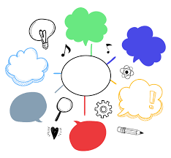
Introduction and Planning
Brainstorming and initial research:
  Involvement of students in the creative process.
  Exploration of key concepts related to vegetable gardens.
Preliminary understanding:
  Meaning and importance of vegetable gardens.
  Basic cultivation techniques.
Preparation for practical activities:
  Creation of a solid base for the next steps.

Slide 3
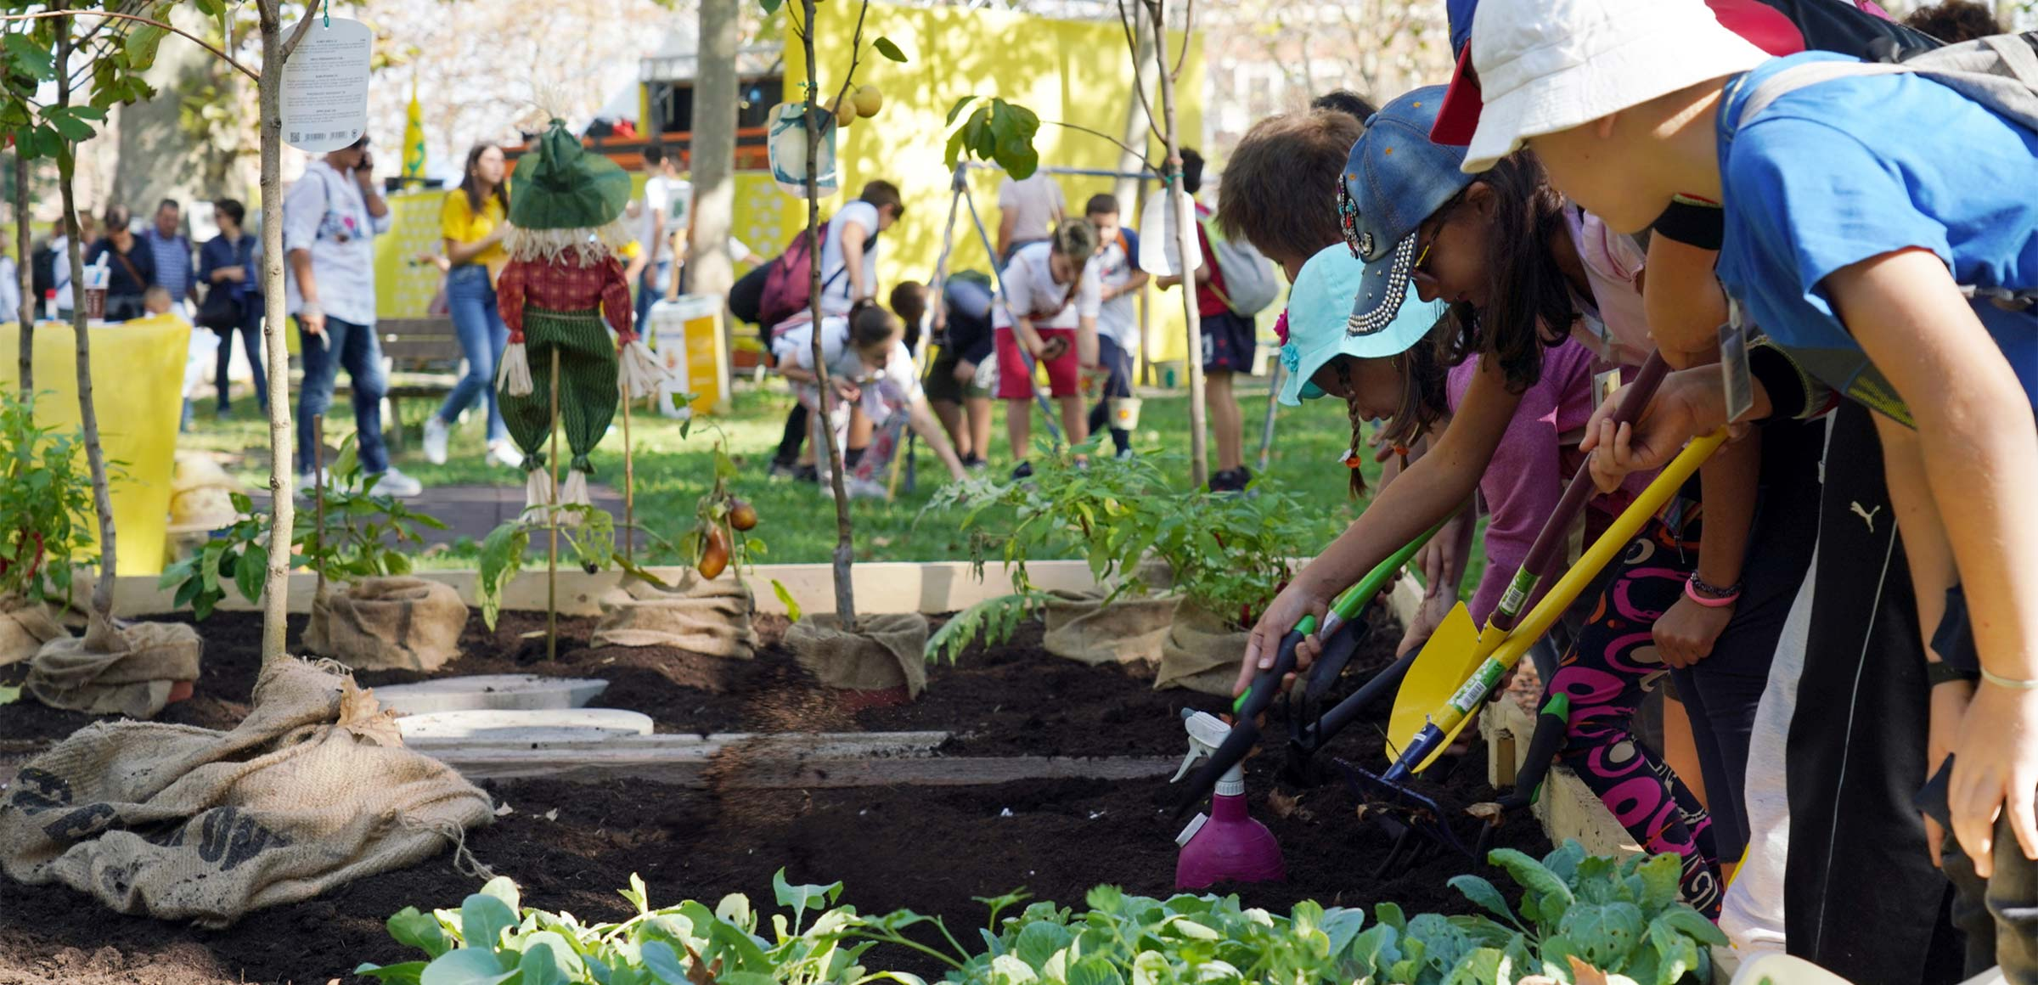
Community Involvement
and Soil Preparation
Involvement of the local community
  Collaboration with parents, grandparents and urban gardens.
  Sharing knowledge and resources.
Land preparation
  Active student participation.
  Learning basic agricultural techniques.
Practical activities
  Sowing and planting vegetables and herbs.

Slide 4
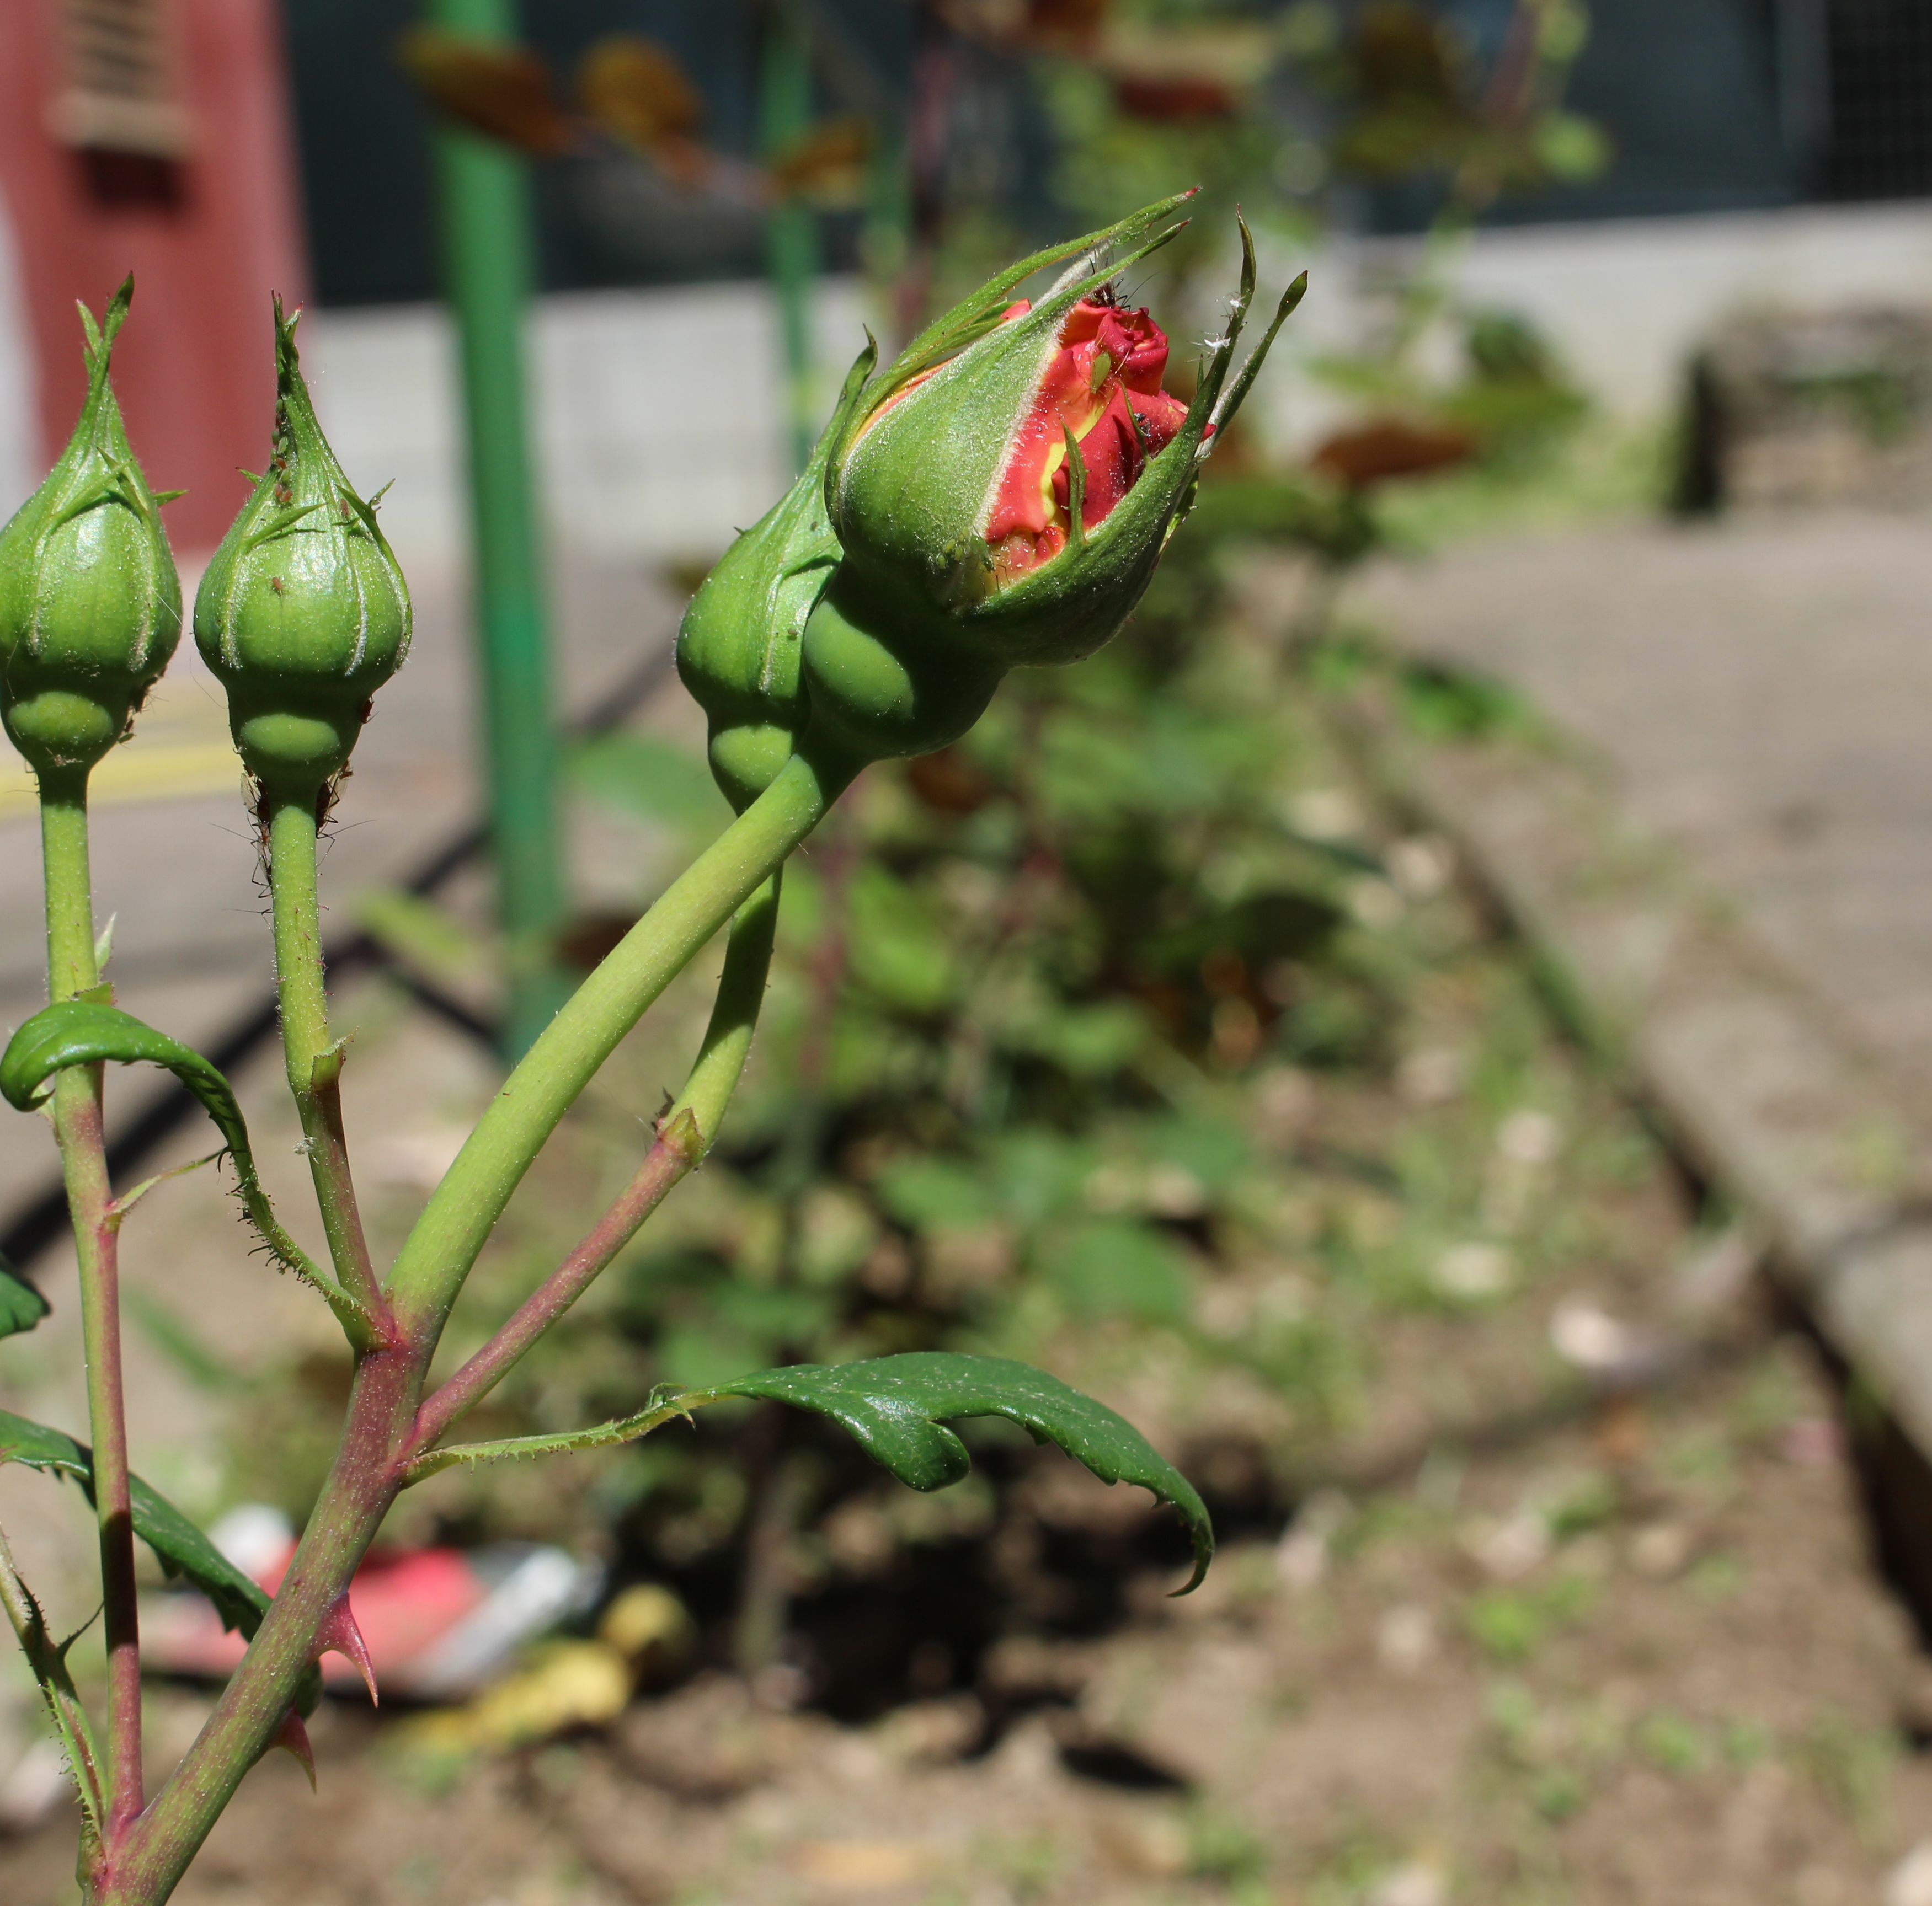
Cultivation
and Care
Student Responsibility
  Daily plant care.
Practical activities
  Irrigation.
  Plant monitoring.
  Garden maintenance.
Key learning
  Importance of constancy.
  Development of a sense of responsibility.

Slide 5
Collection and Use of Products
Collection of products:
  Students harvest vegetables and cultivated plants.
Documentation of the process:
  Recording of activities carried out.
  Promoting reflective learning.
  Sharing experiences with the community.

Slide 6
Evaluation
and sharing
Assessment of competences
  Systematic observations by teachers.
  Practical tests on acquired skills.
Presentation of results
  Sharing of students' work and reflections.
  Involvement of the school community.
Celebrating successes
  Promotion of achievements.
  Valuing the commitment and skills developed.

