Slide 1
Formal Education and non-formal
COMPARISONS AND DIFFERENCES

Slide 2

Key Elements of Formal Education
Definition: Formal education takes place in institutional settings such as schools, colleges or universities.
Structure: It is based on a defined curriculum and follows pre-established rules and regulations.
Phases: Includes primary, secondary and post-secondary education.
Assessment: Involves verification and certification of acquired skills or knowledge.
Objectives: Provides academic, vocational or basic skills.
Certification: Leads to the award of officially recognised diplomas and certificates.

Slide 3
Characteristics of Formal Education:
Organised structure: follows a defined programme based on specific subjects and organised hierarchically.
Predetermined duration: the programme must be completed within a specific time period.
Qualified teachers: instruction is provided by professional teachers.
Structured assessment: includes a chronological evaluation system to monitor student progress.
Educational planning: it is designed to meet specific educational needs through planned courses.

Slide 4

Advantages and disadvantages
of formal education
Advantages:
Structured organisation: well-planned educational system with up-to-date content.
Qualified learning: trained and professional teachers guarantee quality education.
Systematic evaluations: mid-term and final examinations support student progress.
Recognised certification: leads to official diplomas.
Efficient management: the institutions are well organised in terms of management and logistics.
Disadvantages:
Rigidity: less flexible than other learning methods.
Lack of stimulation for the brightest: rigid timetables can bore the most advanced students.
Limited involvement: difficulty in motivating lazy or uninterested students.
Risk of inefficiency: non-professional school offers can waste time and resources.
Complex classroom dynamics: creation of subgroups that are difficult to manage.

Slide 5

Key Elements of Non-Formal Education
Structured and planned programmes: designed to develop specific skills and competences.
Informal context: takes place outside the formal educational curriculum.
Places of learning: includes organisations, sports clubs, theatre and community groups.
Practical and creative activities: project work, games, discussions, camping, music and drama.
Personal and social focus: aims to improve personal development and social cohesion.
Limited recognition: results are difficult to certify, but social recognition is growing.

Slide 6
Characteristics of Non-Formal Education:
Voluntariness: free and non-compulsory participation.
Universal accessibility: ideally open to all.
Targeted organisation: designed with specific educational objectives.
Active participation: actively involving participants.
Learner-centredness: focused on the needs and development of the individual.
Life skills: geared towards practical learning and active citizenship.
Collective approach: combines individual and group learning.
Holistic orientation: considers the holistic development of the participant.
Practical experience: based on action and experiential learning.
Flexibility: adapted to the specific needs of the participants.

Slide 7

Advantages and disadvantages
of non-formal education
Advantages
Practical approach: experiential and concrete learning oriented.
Natural growth: promotes individual development without depending on changes in the formal education system.
Self-learning: enhances autonomy and personal learning.
Flexibility: suitable for different ages, times and contents.
Inclusiveness: open to contributions from both the public and private sectors.
Disadvantages
Instability in participation: participants may have irregular attendance.
Lack of certification: does not provide recognised official certificates.
Limited resources: often lacking adequate funds and materials.
Inadequate space: there may be a lack of adequate facilities provided by local authorities.

Slide 8
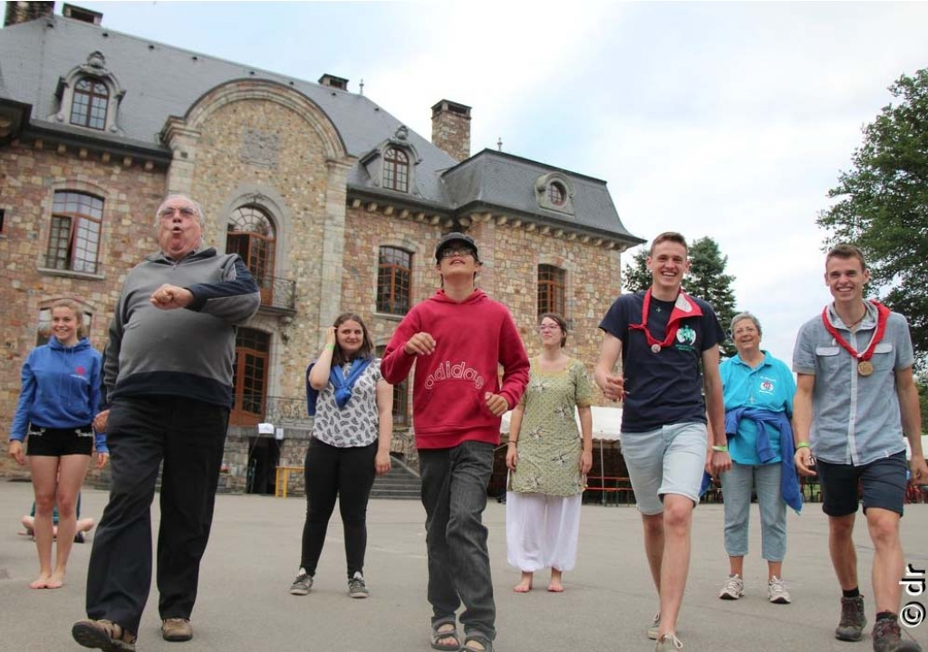
Key Elements of Informal Education
Definition: Lifelong continuous learning.
Sources of learning:
Daily experiences and interactions with the environment.
Family, neighbours, market, library, work, play, and informal sports activities.
Features:
Unplanned and unstructured.
It fosters the acquisition of attitudes, values, skills and knowledge.
Informal areas: Art, reading, and other recreational and cultural activities.

Slide 9
Characteristics of Informal Education:
Independence from physical spaces: it takes place outside the confines of traditional classrooms.
Absence of a programme: does not follow a defined curriculum.
Unplanned: lacking timetables and organised structures.
Continuous learning: a natural process that lasts a lifetime.
Variety of sources: acquired through media, life experiences, relationships with friends, family and other social interactions.

Slide 10
Advantages and disadvantages
of Informal Education
Advantages
Natural and continuous learning: it can take place anywhere and at any time, based on everyday experiences.
Flexibility and customisation: allows individual research on topics of interest through books, social media, internet or informal trainers.
Various methods: uses a wide range of learning techniques.
Time efficiency: enables fast and direct learning.
Accessibility of information: resources include books, digital media, TV, radio and personal conversations.
Disadvantages
Risk of misinformation: sources such as the Internet, social media or personal conversations can spread misinformation.
Inappropriate methods: some techniques may not be effective or relevant.
Lack of structure: the absence of a defined programme can cause confusion and loss of concentration.
Uncertain results: learning may not achieve the intended objectives.

